Slide 1
Mirrored
Personal Distress
Emotional
Affective
Cognitive
Self
Mirrored
Personal Distress
Emotional
Empathy
Notes:
Hey everyone, my name is Josh. I’m a UX Designer at Deloitte Digital and there’s something I want to talk about today. But first, a quick activity

Slide 2
Quick Poll
Raise your hand if you think empathy is a principle of design 🙋
Notes:
Show of hands, who thinks empathy is a principle of design?

Slide 3
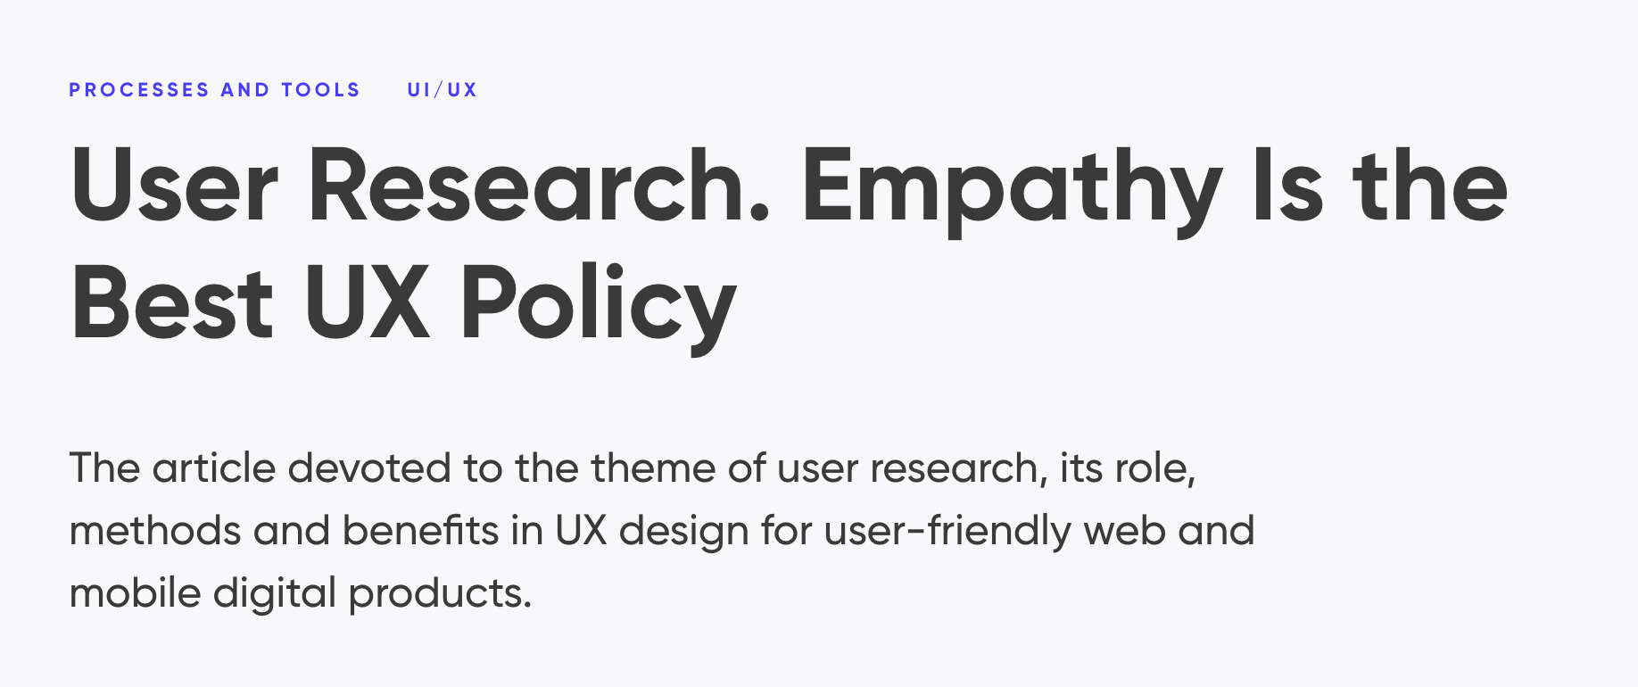
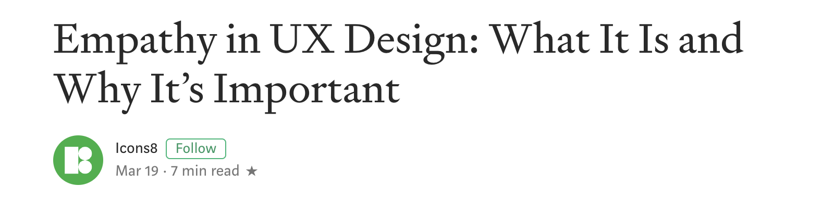

Notes:
If you raised your hand, well, a lot of people agree with you. There are so many designers and product people writing articles out there right now raving and celebrating everything about empathy.

Slide 4
“Empathy
So hot right now.”
- Mugatu
Notes:
In other words, Empathy is so hot right now.

Slide 5
But why is empathy actually important in design?

Slide 6
When is it actually appropriate?

Slide 7
And what is empathy anyway?

Slide 8
Cognitive Empathy
Emotional Empathy

Slide 9
Cognitive Empathy
Emotional Empathy
Understanding what went on in someone’s head as they worked towards something
Feeling the same emotion that another person is feeling

Slide 10
Cognitive Empathy
Emotional Empathy
Asking about the last time someone did something, and listening to the what, why, how, and when
That heart warming feeling when your friend gets married

Slide 11
Cognitive Empathy
Emotional Empathy
Viable in work, specific, and replicable ¹
A ‘morally neutral’, useful tool ²
Like a ‘bolt of lightning’ ¹
A spotlight directing attention ²
1. Indi Young
2. Paul Bloom

Slide 12
Why is cognitive empathy important in design?

Slide 13
Because it calls on us to listen neutrally and mindfully to the end user.

Slide 14
Unlike emotional empathy, we don’t design on lightning bolt feelings as moving as they are.
We listen first.

Slide 15
We must listen neutrally and holistically as professional designers.
That’s the “why” for cognitive empathy.

Slide 16
So does emotional empathy have no use?

Slide 18
When is emotional empathy actually appropriate?

Slide 19
Discover & Define
Develop and Deliver

Slide 20
Discover & Define
Develop & Deliver
?
!
Symptom/Trigger Unspecific problem
Client: ”People aren’t using our website.”
A defined problem informed by discovery
Designer: ”People aren’t able to use it well on phones.”
Notes:
If you raised your hand, well, a lot of people agree with you. There are so many designers and product people writing articles out there right now raving and celebrating everything about empathy.

Slide 21
Discover & Define
Develop & Deliver
?
Cognitive Empathy
as a practice

Slide 23
Your says “nah.”
client,
developer
product manager
analyst
*insert stakeholder here*

Slide 24
Well, remember? Emotional empathy is like a lightning bolt of emotion. A spotlight directing attention.

Slide 25
Emotional empathy is a tool designers can use when hard data isn’t good enough.

Slide 26
Instead of practicing it like cognitive empathy,
We can use emotional empathy to change the hearts of others.

Slide 27
And that is why Personas exist, why Journey Maps exist, and why we value in-field quotes so much.

Slide 28
These tools help us tell stories and stories get people to “switch” by moving their emotional elephants.

Slide 29
Discover & Define
Develop and Deliver
!
Emotional Empathy
as a tool
Notes:
If you raised your hand, well, a lot of people agree with you. There are so many designers and product people writing articles out there right now raving and celebrating everything about empathy.

Slide 30
DO
Practice cognitive empathy in user research to get the full, neutral scoop.

Slide 31
DON’T
Practice emotional empathy in user research because it is biased, exhausting, and not replicable.

Slide 32
BUT…
Use emotional empathy as a storytelling tool to convince stakeholders to switch when numbers alone don’t work.

Slide 33
And remember…
Make sure you understand the semantics of buzzwords before using them.

